Slide 1

guitariffic
web services

Slide 2
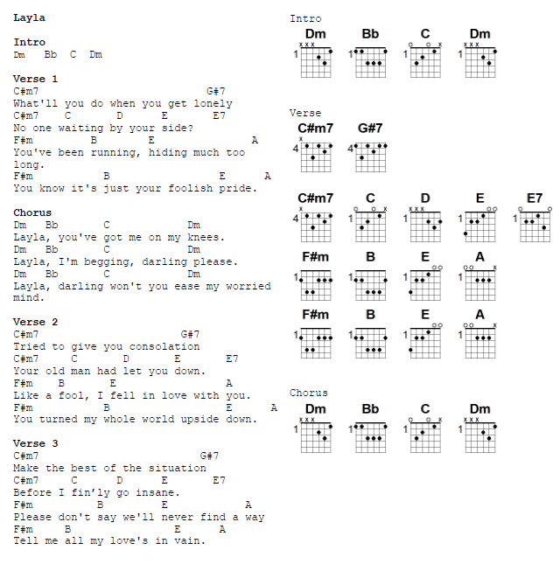
What are guitar fake sheets?
combination of lyrics, guitar charts, and other helpful information to play music

Slide 3
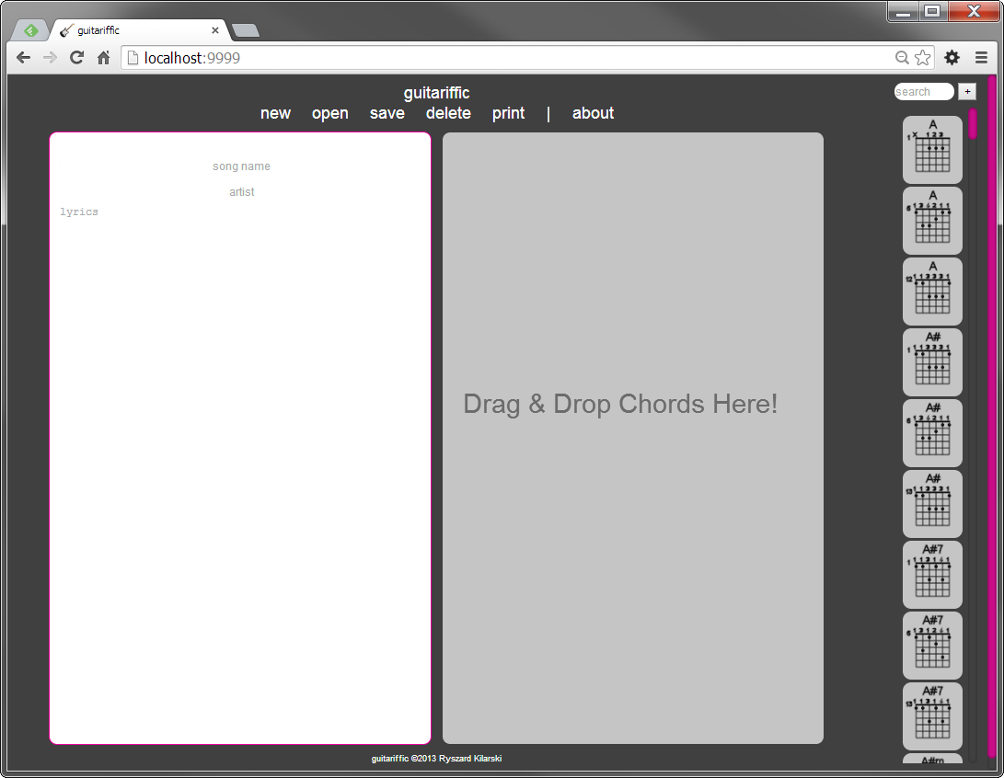
Guitariffic!
designed in cs679
rebuilt in html/js in cs701
servicified in cs751

Slide 4
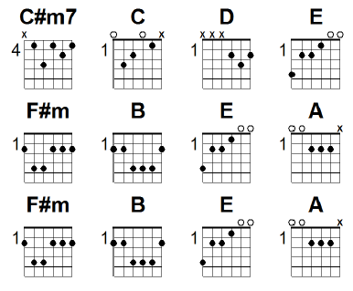
Chord charts
ability to add, edit, delete and search for chord charts

Slide 5
songs
ability to add, edit, delete, and search for songs… AND something extra

Slide 6
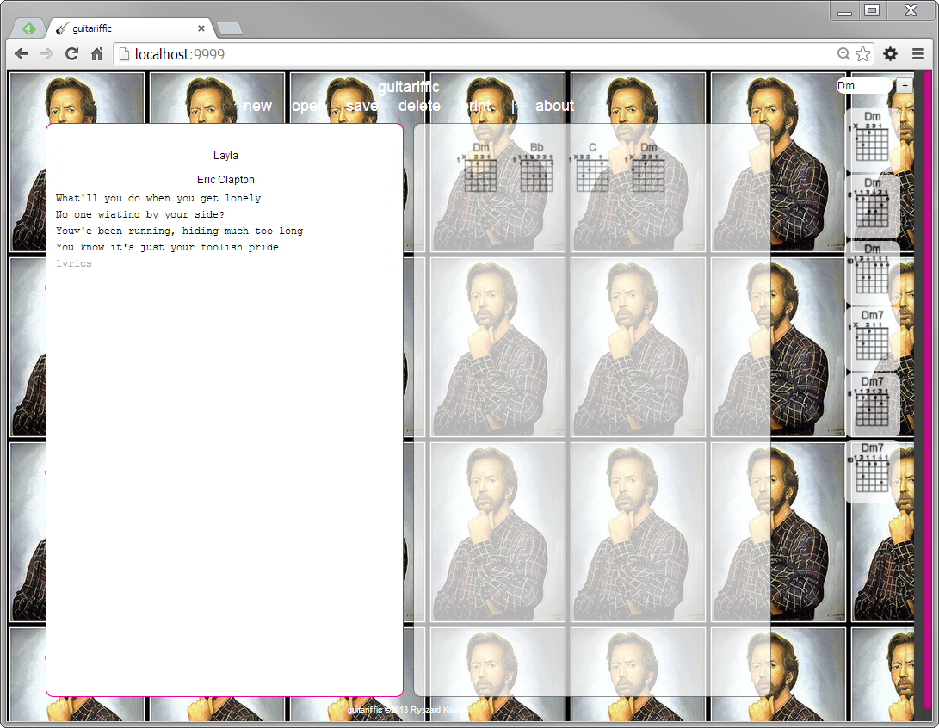
Rotating background Images based on song/artist
isn’t that cool?

Slide 7

Available services
song services
flickr
guitar chart services
whole song services
guitar chart services

Slide 8
Encapsulated image access layer from the song service
<<ImageImpl>>
SongServiceImpl
FlickrImageImpl
flickr
ImageImpl
GoogleImageImpl
Google images
swap image layer with different scheme; currently implemented with flickr only, via REST service

Slide 9
Encapsulated data access layer
<<GuitarChartDBHelper>>
(or <<SongDBHelper>>)
GuitarChartMemoryDBImpl
(or SongMemoryDBImpl)
chords.xml
GuitarChartServiceImpl
(or SongServiceImpl)
StorageFactory
GuitarChartSqlDBImpl
(or SongSqlDBImpl)
swap data layer with different scheme; currently implemented in-memory representation of charts and songs
charts also load a starter set from an xml file

Slide 10
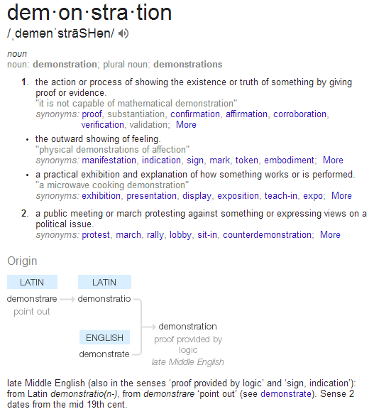
Rest and soap services
wsdl
REST-based test client
SoapUI to test SOAP services

Slide 11
guitariffic ?

